Slide 1
Steam Games Data analysis
Zoe Mecklenburg and Kadin McWilliams

Slide 2
agenda
Dataset Explanation
Our Questions
Findings
Summary
Your Questions

Slide 3
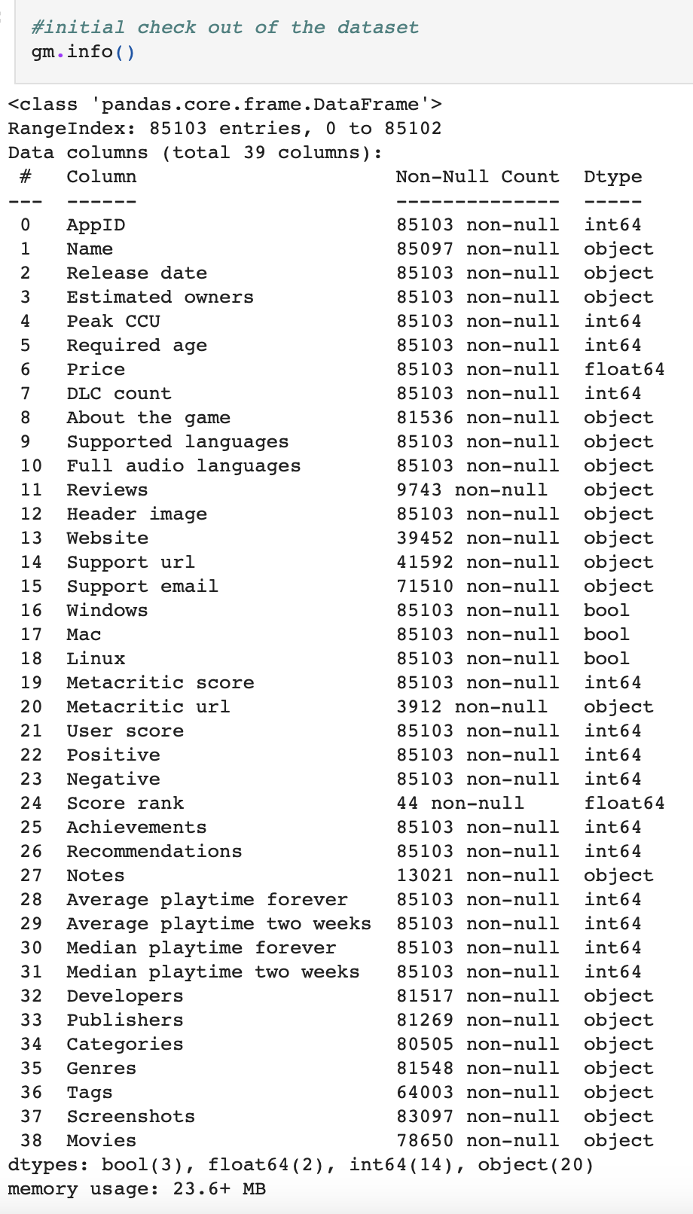
Steam Games Dataset

Slide 4

What do we want to know
Top 5 types of games
Top 5 most popular games
How does Peak CCU impact Reviews?
What are most people playing games on?

Slide 5
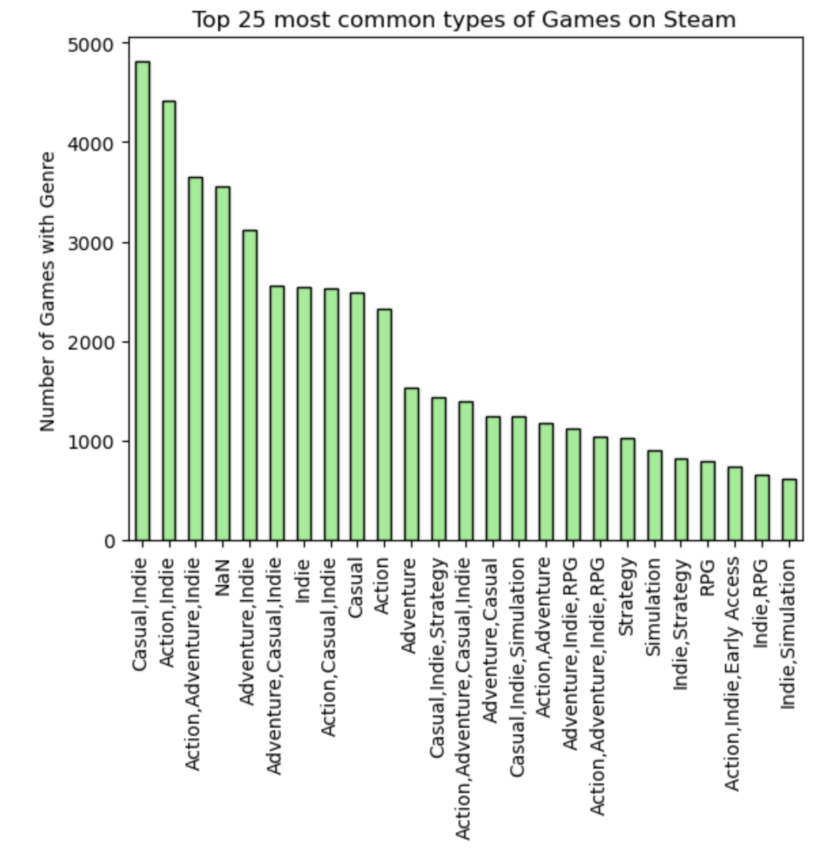
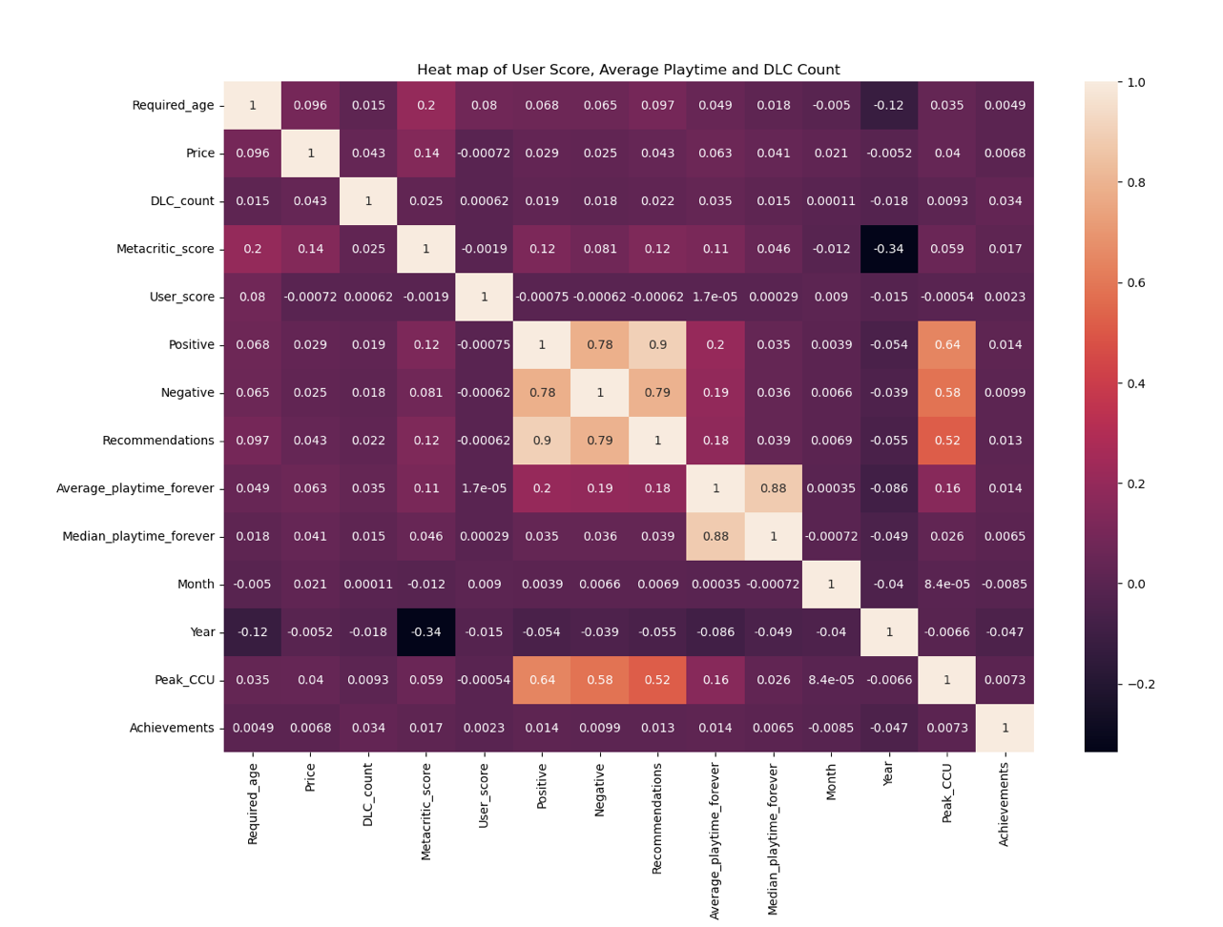
What are the top 5 types of games?

Slide 6
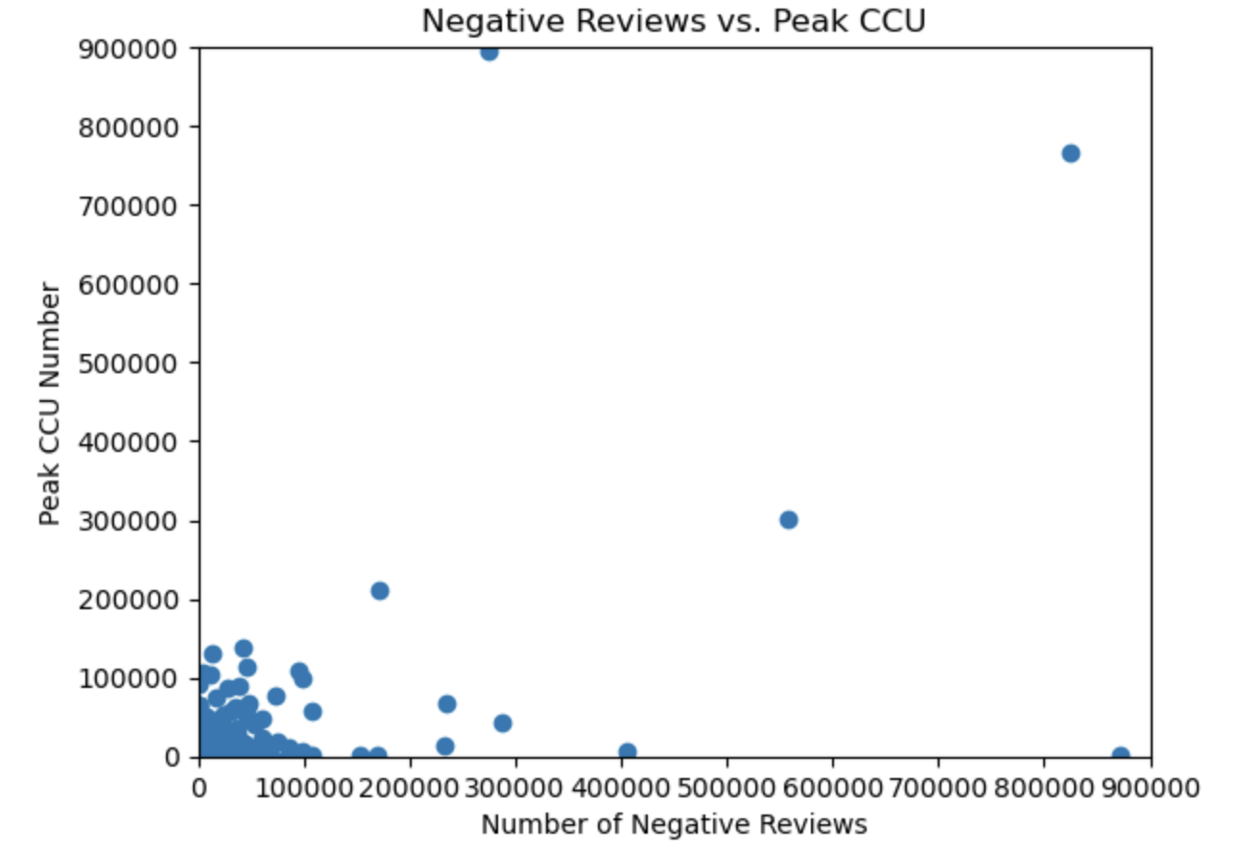
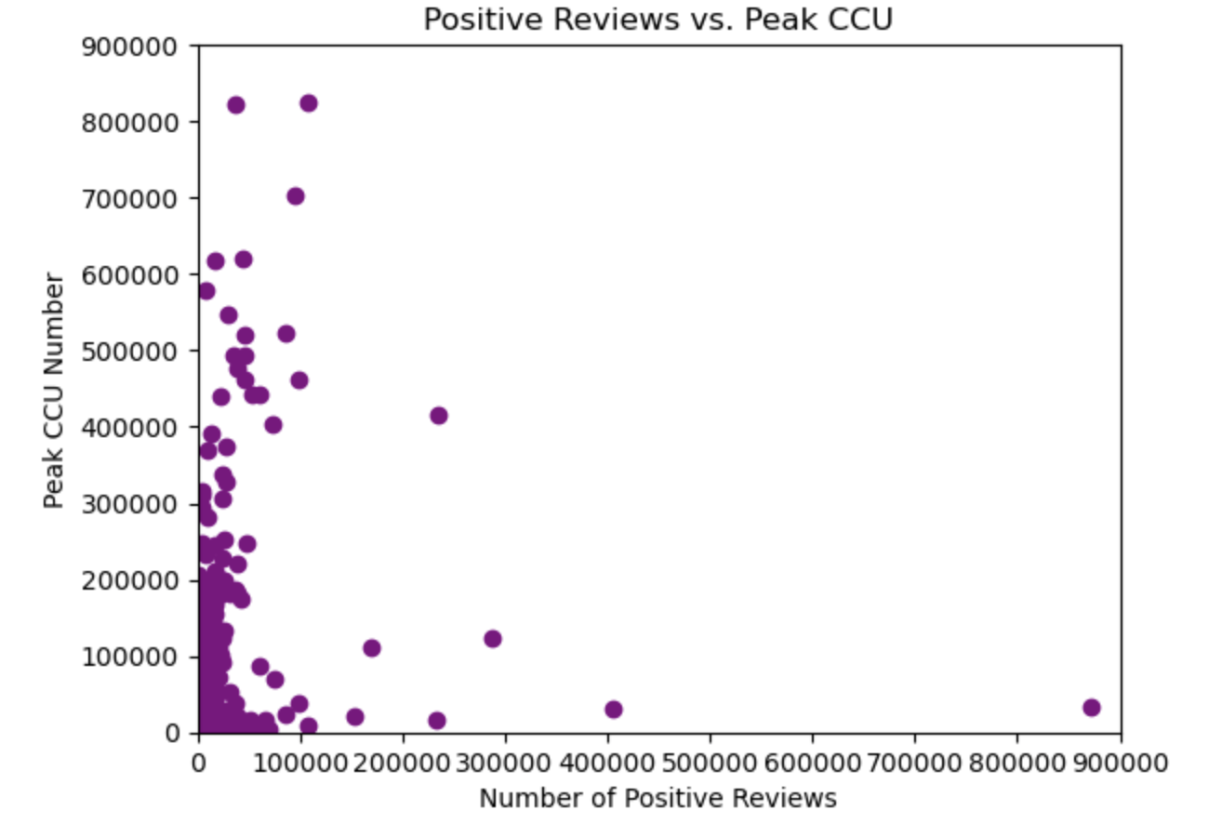
Types of Reviews vs PEAK CCU

Slide 7
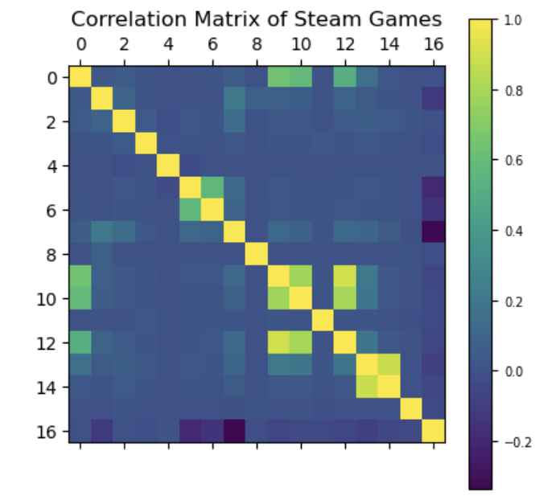
What are the top 5 most popular games?

Slide 8
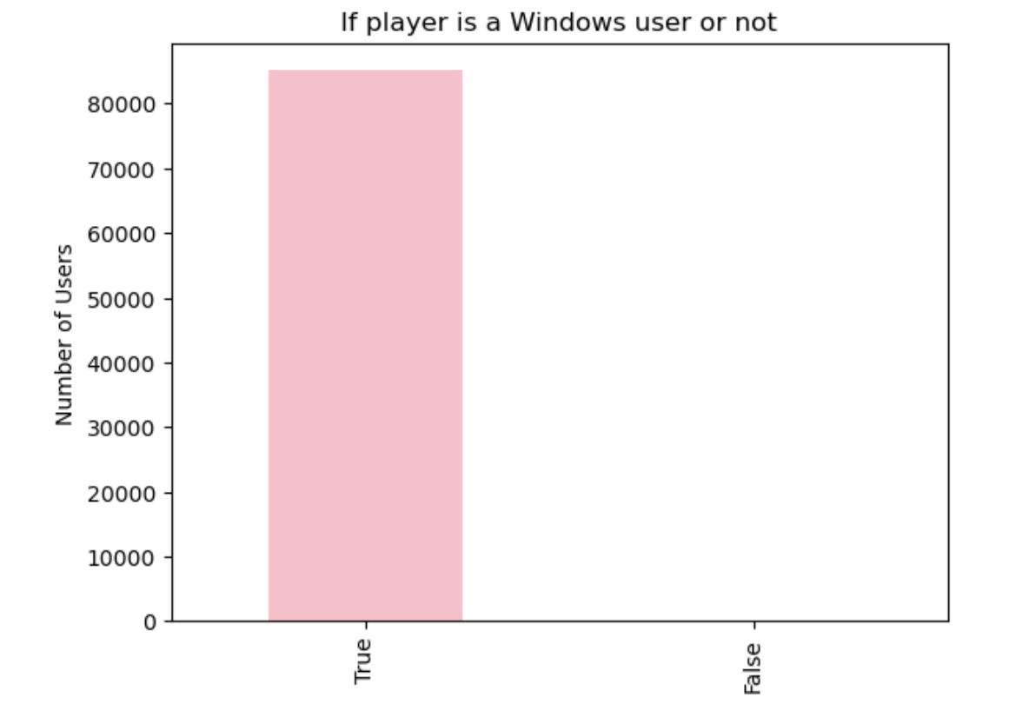
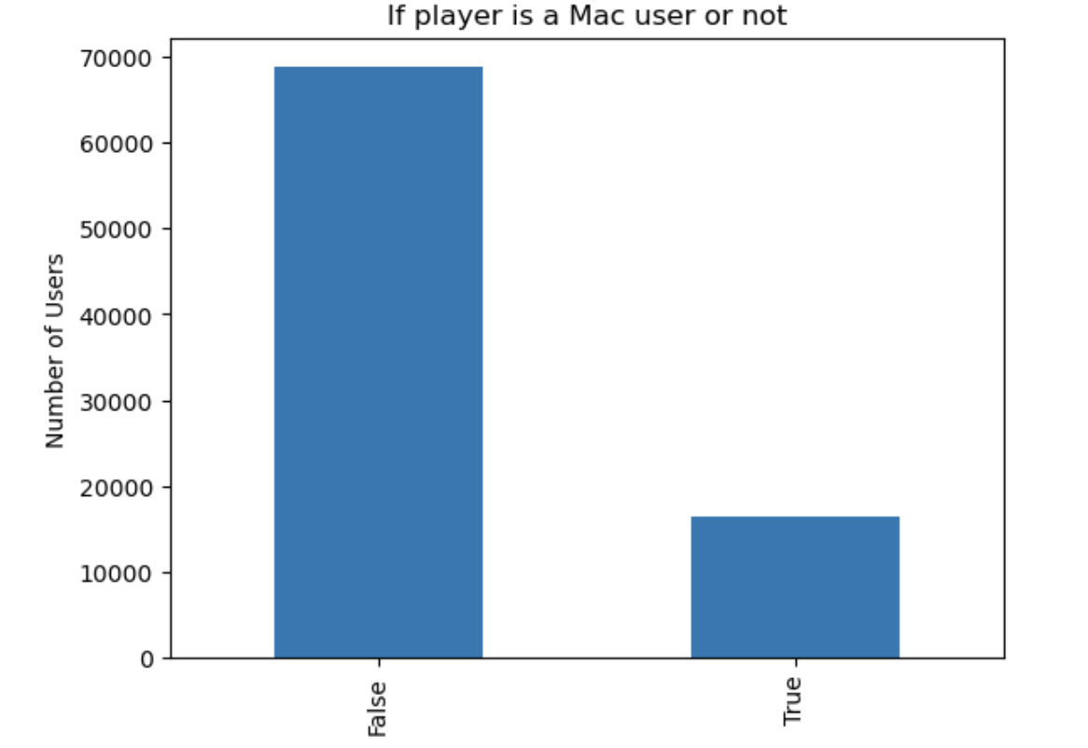
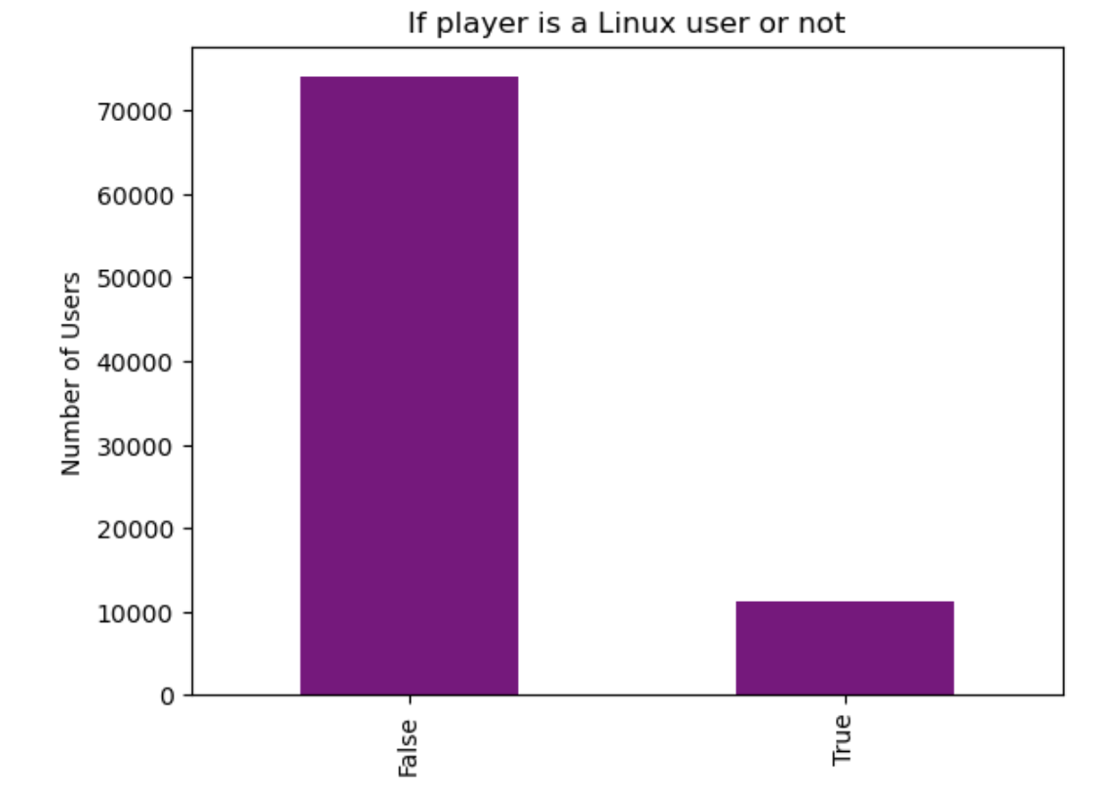
What are most people playing games on?

Slide 9
Overall Summary
Significance of Action games
Indie games fluctuation
Multiplayer games
Windows users
Peak CCU

Slide 10
Questions?

